Slide 1

International Seminar PIPE-MUFRAMEX
The other transitions: PUENTES a policy program for returned migrant higher education students
Mónica I. Camacho Lizárraga, Ph.D. (PIPE CIDE)
Santiago Castiello-Gutierrez, Ph.D. Candidate (University of Arizona)
Interdiscipinary Program for Education Policy and Practice (PIPE)
Research and Teaching Center in Economics (CIDE)
11/6/2018

Slide 2

Contents
Image: International Seminar PIPE-MUFRAMEX program
Context
TF: Return migration (“retornados”) + policy perspective
PUENTES program
Research questions & methodology
Findings & conclusions

Slide 3
Context
International student mobility
  For enlightenment, opportunity or social mobility
  vs. mobility for survival.
  Also follows similar geographical patterns: from the South to the North, from lower-income countries to higher-income countries.

Slide 4
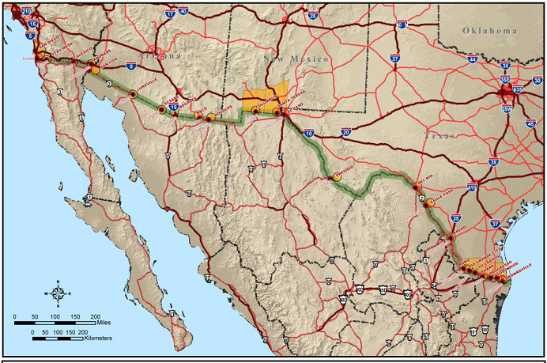
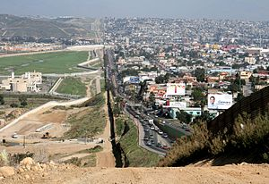
Mexico-U.S. border (3.185 km)
  France: 2.751 km with 8 countries
U.S.
Mexico
Images: https://en.wikipedia.org/wiki/Mexico%E2%80%93United_States_border#/media/File:United_States%E2%80%93Mexico_border_map.jpg
https://en.wikipedia.org/wiki/Mexico%E2%80%93United_States_border#/media/File:Border_USA_Mexico.jpg

Slide 5
Mexico-U.S. immigration
  Estimated in 2014, over 12.1 million unauthorized immigrants in the U.S. (Baker, 2017), and that over half of them were born in Mexico (6.6 million).
  20% are Mexicans under the age of 24 (living in the U.S. most of their lives), compared to other ethnic immigrant groups.

Slide 6
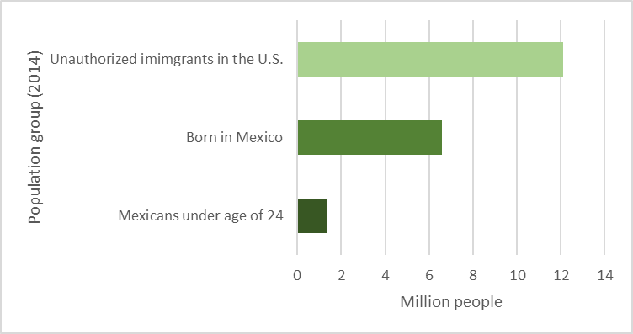

(Baker, 2017)
Changing Mexico-U.S. immigration context
  U.S. 2016 Presidential election
  Policies to reduce the number of immigrants from specific countries .
  Imposing travel bans and/or increasing deportation orders.
Image: Monica Camacho

Slide 7
Return migration (“retornados”)
Terminology (González-Barrera, López & Rohal, 2015; Jacobo, 2015)
  Deportation (U.S. numbers); repatriation (MX monthly count); forced return (U.S. numbers / MX numbers); voluntary return (MX numbers every 5 years).
Inter-cesus Survey 2015 (Encuesta Intercensal, EIC by Federal Statistics Bureau, INEGI) identified 559,416 people that lived in the U.S. five years before.
  It represents 0.5% of total Mexican population (119, 520,753)
  (El Colegio de Mexico, 2017).

Slide 8
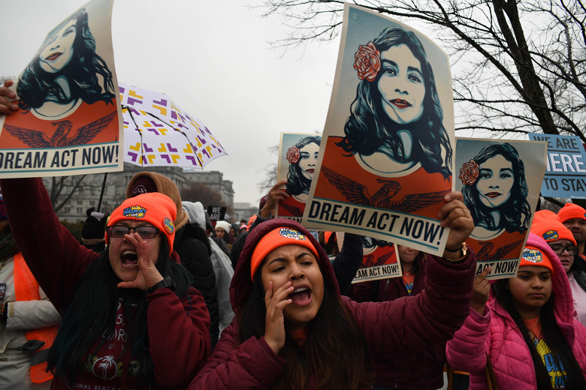
Return migration (“retornados”)
Dreamers: A group at risk
DREAM Act (2012) (Development, Relief and Education for Alien Minors Act, DACA).
  Administrative relief from deportation
  Unauthorized immigrants living in the U.S. for at least 5 years, completed high-school, no convictions, and entered the country before the age of 16.
Image: Seattle Times (Miguel Juarez Lugo/ZUMAPRESS.COM/TNS)
https://www.seattletimes.com/nation-world/what-we-know-%C2%AD-and-dont-know-about-daca-dreamers/

Slide 9
“Dreamers”
689,821 (79% Mexican) (Pew Research Center, 2017).
With DACA, eligible students…
  Could enroll at a higher education institution –in some cases paying the reduced in-state tuition fees; and apply for a work permit.
  BUT…
  a White House executive order rescinded the DACA program (September 5 of 2017) and has been in litigation since then.

Slide 10
PUENTES program
Program for the continuity or culmination of Tertiary Studies (Programa Universitario Emergente Nacional para la Terminación de Estudios Superiores, PUENTES).
Launched by the National Association of Universities and Higher Education Institutions (ANUIES) in March, 2017.
Joint effort with the Federal Government (Ministry of Public Education, Ministry of External Relations).

Slide 11
PUENTES program
Basis: Previous modifications to normativity related with requirements for education documents issued abroad (i.e., apostille, legalization and official translation) (SEP, 2015).
Modifications were aimed at benefiting a numerically larger population (i.e., transnational students at all levels of education).
Resulted from collaborative work of NGOs, academics and affected return migrant groups.

Slide 12
PUENTES program
Temporary program (2017-2020).
Facilitates Mexican students living in the U.S. –that could eventually be either deported or who voluntarily decide to leave the U.S.– enroll at a Mexican higher education institution to finish their degrees.
Streamlined process through a web portal:
  More than 5,000 programs at 400 universities and HEIs, both public and private.
Participating institutions: provide admission, offer pathways for scholarships or other forms of financial aid, and expedite paperwork needed for students to enroll.

Slide 13
Research questions & methodology
Guiding questions:
  How is the PUENTES program effectively to the problem of return migrant students?;
  What elements of the program and the process are being considered as enablers or inhibitors of meeting its goals?
Qualitative study:
  Interviews with individuals identified as stake-holders.
  Survey to the designated contact person for PUENTES at higher education institutions participating in the program.

Slide 14
Findings (interviews)
Participant I. Representative from ANUIES on the results of PUENTES by the end of spring semester of 2018.
  114 applications received
  Only 62 were valid (i.e., the rest were
  duplicates, incomplete, invalid, or ineligible).
  55 were still in process and only 7 resulted
  in the admission and enrolment of those students.
  Almost half of the valid applications came from students who began their studies in border states in the U.S. (California, TX, and AZ).
114
62
55
7

Slide 15
Findings (interviews)
Participant II. Chairperson from Chicanos por la Causa, U.S.-based NGO providing support to the Hispanic population in the Southwest region.
  Helped us understanding the background of several issues (i.e., anti-immigration policies, groups at risk – “dreamers”, and activism as a response) at the local level.
  She was not aware of the PUENTES program, but…
Participant III. Scholar that combines research with activism.
  Expanded our understanding on the political profitability of the RM phenomenon, and on the policy modifications that preceded PUENTES.
  She was not aware of the PUENTES program and highlighted “red flags”.

Slide 16
Findings (Survey)
Online survey to PUENTES contact person at each HEIs
490 coordinators from 399 institutions were identified.
487 recipients at 396 HEIs.
Only 71 individuals opened the link to the survey
42 complete responses were gathered
  →11% response rate of all the institutions listed.

Slide 17
Findings (Survey)
n = 42 | Frequency
To what extent do you agree or disagree with each of the following statements: | Agreement | Neutral | Disagreement
The PUENTES program is an effective inter-institutional strategy that responds to a social problem, given the political and social situation Mexicans experience living in the U.S. | 86% | 12% | 2%
The PUENTES program partially resolves that returning students from the U.S. can finish their degree in Mexico. | 83% | 10% | 7%
The PUENTES program does not resolve the issue of returning students from the U.S. continuing their degree in Mexico. | 21% | 26% | 52%
The PUENTES program has been sufficiently communicated among Mexican students in the U.S. so that they can take advantage of it. | 32% | 44% | 24%

Slide 18
Findings (Survey)
n = 42 | Frequency
To what extent do you agree or disagree with each of the following statements: | Agreement | Neutral | Disagreement
The PUENTES program adds bureaucracy to existing processes at my current institution. | 34% | 29% | 37%
The PUENTES program generates inequality because it allows students to get an available space from others who already live in Mexico. | 29% | 19% | 52%
PUENTES is neither the first nor the only option available to Mexican students in the U.S. who wish to continue with their studies in Mexico.
Over 60% of the institutions indicated that they have received in the past applications.

Slide 19
Conclusions
Return migration from the U.S. to Mexico not a new phenomenon.
The analysis also shows that we are facing a multifaceted issue that exceeds just opening spaces at HEIs located in Mexico.
Difficulties return students could face include emotional, linguistic, financial, social, and cultural as previous scholarly work has documented (Zúñiga & Hamann, 2006; Zúñiga, Hamann & Sánchez, 2008).
PUENTES: As a policy based program, a reactive response.
In good will, it appeals to the social responsibility of Us & HEIs.

Slide 20
Conclusions
PUENTES is a first step but effective policies need surpassing mere rhetoric and being comprehensive.
PUENTES:
  Contributed by providing at least a streamlined pathway for return students and;
  by pushing the topic to the public agenda;
  Opening path for further normativity modifications.
Communication strategy: reach-out stakeholders.
Review (profile) who is left out.
In its current status, is far from being the solution and re-sponse to such a complex issue.

Slide 21
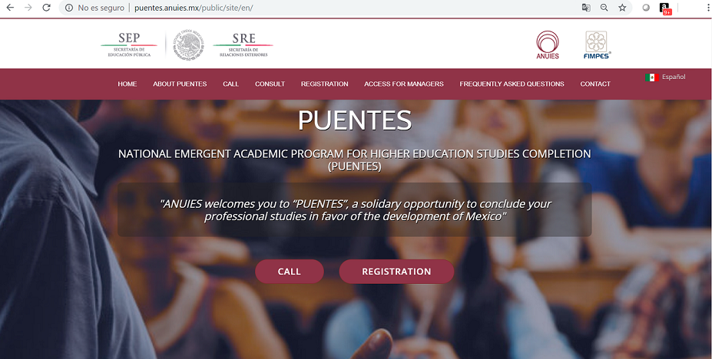
http://puentes.anuies.mx/public/site/en/

Slide 22
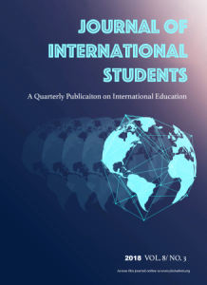
Accepted chapter (Book, forthcoming)
Rethinking Education Across Borders: Emerging Issues and Important Insights on Globally Mobile Students
Springer
Editor:
Dr. Uttam Gaulee, Morgan State University
Co-editors:
Shyam Sharma, Stony Brook University
Krishna Bista, Morgan State University,

Slide 23
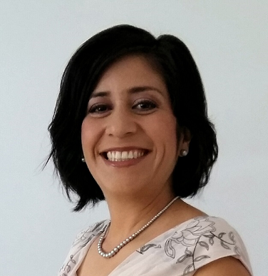
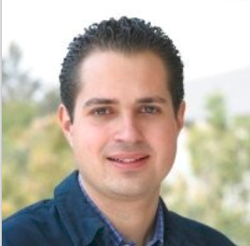
Mónica I. Camacho Lizárraga, Ph.D.
Researcher
Programa Interdisciplinario sobre Políticas y Prácticas Educativas (PIPE)
Centro de Investigación y Docencia Económicas (CIDE)
Santiago Castiello-Gutiérrez
Doctoral Candidate
University of Arizona
Consortium for North American Higher Education Collaboration
monica.camacho@cide.edu
https://www.pipe.cide.edu/
santiagocg@email.arizona.edu

Slide 24
References
ANUIES (2017). Programa universitario emergente nacional para la terminación de estudios superiores [National emerging university program for the culmi-nation of tertiary studies] Retrieved from http://puentes.anuies.mx/public/site/
Baker, B. (2017). Estimates of the unauthorized immigrant population residing in the United States: January 2014. Department of Homeland Security. Re-trieved from: https://www.dhs.gov/sites/default/files/publications/Unauthorized%20Immigrant%20Population%20Estimates%20in%20the%20US%20January%202014_1.pdf
El Colegio de México (2017). Migración de retorno y derechos sociales. Barreras a la integración. Indicadores. Retrieved from http://migracionderetorno.colmex.mx/indicadores/
González-Barrera, A., Lopez, M. & Rohal, M. (2015). More Mexicans leaving than coming to the U.S. Washington, DC: Pew Research Center. Retrieved from http://www.pewhispanic.org/2015/11/19/more-mexicans-leaving-than-coming-to-the-u-s/
Jacobo, M. (2017). De regreso a “casa” y sin apostilla: estudiantes mexicoamericanos en México [Back "home" and without apostille: Mexican-American students in Mexico]. Sinéctica, (48) 1-18.
Pew Research Center (2017). Top countries of origin for DACA recipients. Retrieved from http://www.pewresearch.org/fact-tank/2017/09/25/key-facts-about-unauthorized-immigrants-enrolled-in-daca/ft_17-09-25_daca_topcountries/

