Slide 1

The French Education System
Cécile CRESPY
Professor of political science - Sciences Po Toulouse
Philippe RAIMBAULT
Professor of public law – Sciences Po Toulouse
President of University of Toulouse
International Seminar :
Transition between High-School and University. Comparative studies between Mexico and France
November 5-7th, 2018

Slide 2
Historic perspectives
of French Education System
- During centuries, until the Revolution of 1789, education is a private activity, fully developed by religious congregations.
- Progressive secularization since 1789 that leads to the Ferry Laws in 1881/1882 : primary school is public, free and secular. Education is mandatory from 6 to 13.
- Huge role of primary school teachers, called “hussards noirs”, to strengthen the Republic.
- Creation of Ministry of National Education – instead of Public Education as since 1828 - in 1932 => tradition of equality and centralization in French public policies of Education.
Notes:
Private tutors for rich families

Slide 3
Main steps in
French Education System
- Compulsory education from 6 to 16, except in some overseas territories (often 5) ; law in progress to make it mandatory from 3 years old.
- Main steps:
+ nursery school during 3 years (from 3 to 5)
+ elementary school during 5 years (from 6 to 10)
+ middle school (called « college ») during 4 years (from 11 to 14)
+ high school during 3 years (from 15 to 17) with final examination called “Baccalauréat”, that gives access to higher education.
+ Higher education : From 19 to 117…
Notes:
Nowadays, 97,5% of children of 3 are send to school, so around 25 000 are not registered.
HS : can be a vocational School

Slide 4

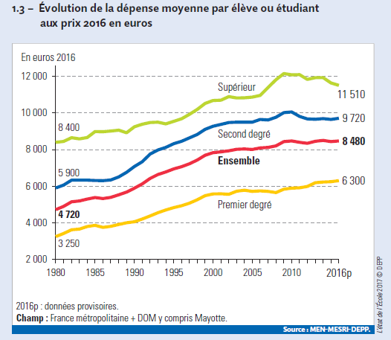
Expenses per pupil or student

Slide 5
Main Structuring Principles
of French Education System
- Freedom of Education : the State shall respect the right of parents to ensure such education and teaching in conformity with their own religious and philosophical convictions => separation between private and public schools (around 16% of pupils are registered in private schools).
The State has a control on main part of the private schools (by the mean of contracts and financial support).
- Centralization: weak role of local authorities (except in overseas territories as Nouvelle-Caledonie or Polynésie française) on education issues. Programs and exams are national ones; teachers are state civil servants. Local authorities are mainly involved in building and maintenance of the properties.
- Autonomy: adaptation to the territories and publics.
Notes:
13% for elementary schools and 20% for secondary schools

Slide 6
The Governance
of French Education System
One strong public policy since 2000’s : more autonomy for the players of education system.
Elementary schools : only loose projects, but no real autonomy (no legal entity, few freedom for players).
Secondary schools (middle and high schools): autonomy is enounced, experienced since 2005, but still shy (legal entity, possibility of experimentations but control from Rectorat remains strong and increasing role of local authorities)
Higher education: Autonomy is increasing, especially since 2007.

Slide 7
Higher Education System:
the Napoleonian Model
A higher education system historically shaped:
A divide between universities and “Grandes Ecoles”
For a long time, universities were not the core of the HE system. Universities were not the core of the research system too.
  Existence of National Research Institutes (CNRS, INSERM, INRA...)
The State as a key actor of the HE system: centralisation
Autonomy of the universities: LRU Law (2007)

Slide 8
Higher Education System:
the Napoleonian Model
A higher education system faced to transformations:
The increase of number of students: in the 1960s, in the 1990s and in the 2010s.
Transition between high school and HEI: selective and non selective process.
  A new process with Parcoursup
There are few ties between high school and HEI.
  Bac-3/bac+3

Slide 9
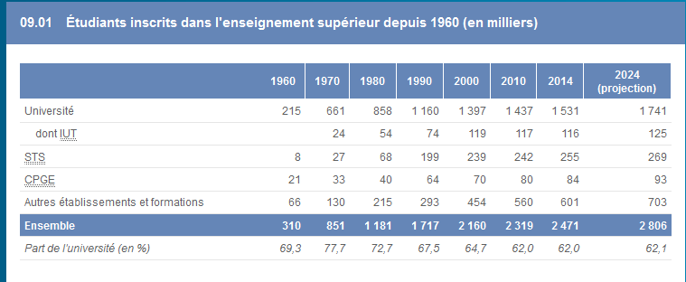
Evolution of the number of students

Slide 10
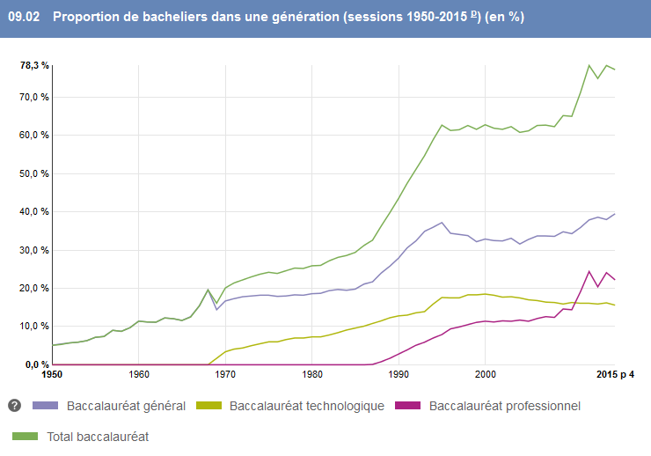
Number of graduates from high school diploma “baccalauréat”

Slide 11
Higher Education System:
the Napoleonian Model
A higher education system faced to transformations:
The increase of number of students: in the 1960s, in the 1990s and in the 2010s.
Transition between high school and HEI: selective and non selective process.
  A new process with Parcoursup
There are few ties between high school and HEI.
  Bac-3/bac+3

Slide 12
Higher Education System faced to the Reforms:
the Napoleonian Model Dethroned?
A higher education system faced to the reforms:
The Bologna Process in the early 2000s:
  LMD reform
  A kind of convergence between universities and “Grandes Ecoles”
Organisational reforms since mid 2000s:
  Autonomy of the universities: LRU Law (2007)
    A recent phenomena and difficulties
  Cooperation at a territorial level: PRES, COMUE
  Policies for excellence (“Grand Emprunt”), “merger” mania

Slide 13
Higher Education System faced to the Reforms:
the Napoleonian Model Dethroned?
A higher education system faced to the reforms:
Internationalisation and Europeanization of HE system.
  Many scripts (Musselin, 2008)
The French centralisation remains in spite of the managerial turn.
  A more evaluative State (Neave)
A divide between universities and “Grandes Ecoles” remains too.

Slide 14
The French Education System
Thank you for
your attention!

