Slide 1
The new challenge of academic guidance
in Higher Education
Philippe RAIMBAULT
Professor of public law – Sciences Po Toulouse
President of University of Toulouse
International Seminar :
Transition between High-School and University. Comparative studies between Mexico and France
November 5-7th, 2018

Slide 2
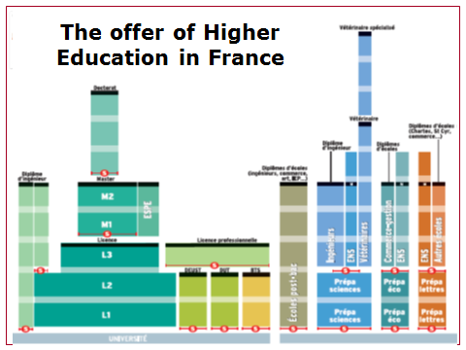
Academic guidance : a challenge ignored

Slide 3
Academic guidance : a challenge ignored
The French higher education system is really a very complex system with many players in the public policy :
- Hard to understand for students and partners;
- A lot of tiny institutions (around 1000 students);
=> Academic guidance should be useful and developed.
But, usually, guidance is not really a priority neither for « Grandes écoles » nor universities :
“Grandes écoles” select their students and success rate is very high
Universities have to host all students that have their Baccalauréat, almost without possibility to select.

Slide 4
Guidance as a renewed necessity
- Recently, a crucial step : Law “Academic guidance and Success of Students” in March 2018 change the process of recruitment in higher education.
The main aim is building an individual path of education for each student and struggling against failure by a better support.
Notes:
Private tutors for rich families

Slide 5
Guidance as a renewed necessity
- New process of recruitment:
The student can do 10 choices on a platform called Parcours sup’ ;
Each institution answer on the base of the application file (scholar results, motivation…) and can say :
- “no”, only for selective programs
- “yes”
- “yes, but…” you have to complete your education path with preliminary courses because your scholar background doesn’t prepare you enough to this program. Or creation of new programs dedicated to students less prepared to the discipline.
Each time the student have 2 positive answers, he has to choose one.
When he has made his definitive choice, registration in the institution.
Notes:
Private tutors for rich families

Slide 6
Guidance as a renewed necessity
This new process involves that each student build a reflection about his path of education and the career he plans to do.
That’s why the reform of high school that is currently launch provides for integrating 2 hours each week during the 3 years of high school to work about academic guidance.
Notes:
Private tutors for rich families

Slide 7
The French education system
Thank you for
your attention!

