Slide 1
International influences on the politics of student transition to HE: the case of Baltic States
From High School to University: Comparative Studies between Mexico and France
5 November 2018, Toulouse
Teele Tõnismann
Sciences Po Toulouse (LaSSP)
Tallinn University of Technology (RNI)

Slide 2
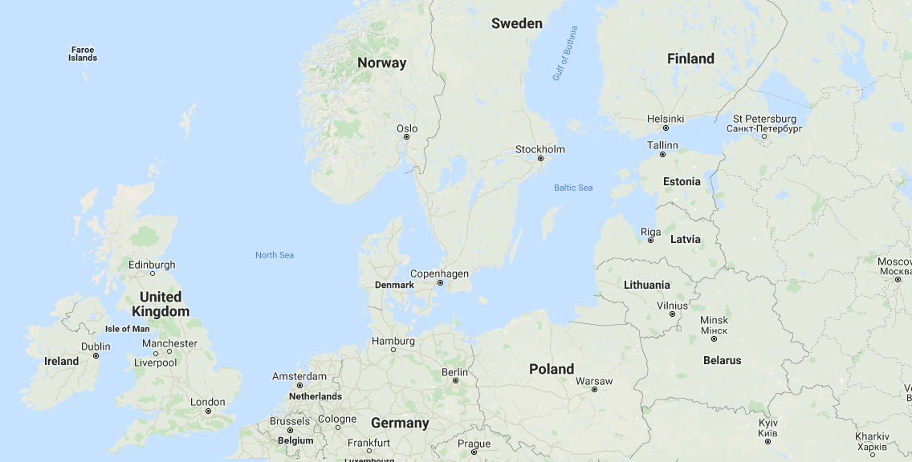
Estonia
1,3 million inh.
EU: 2004
OECD: 2010
Latvia
1,9 million inh.
EU: 2004
OECD: 2016
Lithuania
2,8 million inh.
EU: 2004
OECD: 2018

Slide 3
Question:
In what way are international organisations (EU, OECD) influencing the Baltic States’ HE entrance policies?
Approach:
Bottom-up: academic disciplines in the context of national HE reforms
Empirical case:
Sociology discipline
Data:
Retrieved from on-going PhD

Slide 4
In 1999 | Estonia | Latvia | Lithuania
Number of HEIs | 37 | 33 | 15
Students | 40 621 | 76 653 | 74 532
Fee paying students | 50 % | 50 % | 21 %
Students in social sciences | 41% | 44% | 40%
International organisations :
equity in HE entrance ? (OECD)
alignment of HE policy with economic development ? (EU)

Slide 5
Estonia
Major reform in 2012-2013
“Lump-sum” funding model with universities having the right to decide study places. Free HE in Estonian-language programmes
No additional income -> closure or consolidation of sociology progams with other study areas
Latvia
No major HE funding reforms
State commanded places and full fee-paying student places (23% in 2016)
Developing programs in sociology
Lithuania
Major reform in 2009
Decoupling student numbers from funding: “voucher system” and fee paying students
Fewer full positions for teaching staff -> closure of programs in sociology

Slide 6
Students enrolled in BA or equivalent level studies in 2016 (source : Eurostat)
 | Estonia | Latvia | Lithuania
Total BA graduates | 33 134 | 49 395 | 102 425
Sociology and cultural studies | 334 (1 %) | 1497 (3 %) | 467 (0,4 %)

Slide 7
Thank you for your attention
Teele Tõnismann
Sciences Po Toulouse (LaSSP)
Tallinn University of Technology (RNI)

